Slide 1
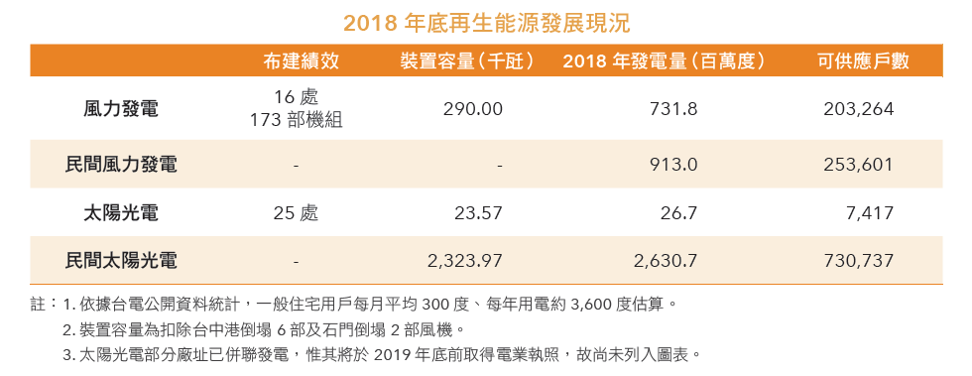
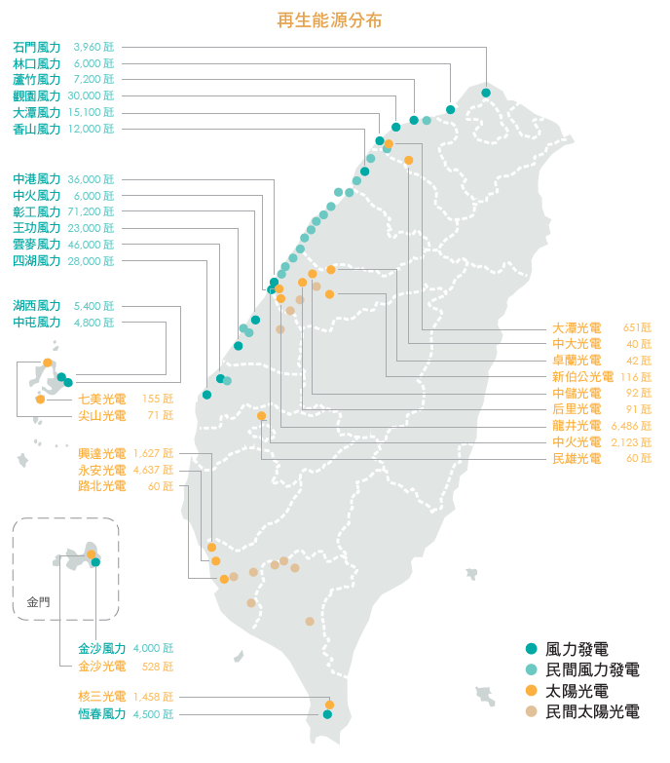
Taiwan Power Company continues to play a leading role . In addition to it’s nearly 100 year history in hydropower generation , Taiwan power company also has a complete developmentplan for power and solar photovoltaic in recent years and has invested in emerging areas such as geothermal and biomass energy research and development .
The status of renewable energy development includes hydropower wind power and solar photovoltaic .
Since 2000 , it has committed to the development of wind power photovoltaic system have been planned for the implementation of solar photovoltaic instruments . By the end of 2018 , a total of 23 sgeneration . By the end of 2018, it has completed wind power generation . It is its plan . There are 16 wind farms with 173 parts in total .
It also facilitates the development of hydropower generation . It has a history of nearly a century and has a capacity of 209million networks by the end of 2018. the domain name occupies a renewable energy source with a total installed capacity of half.
Since 2008 , a large number of solar olar power plants have been completed with a device capacity of more than 1.8 trillion .
Taiwan electric power corporation continues to research and develop green energy renewable resource with the country increasing emphasis on environmental issues and the continued experience of batteries , it has incorporated civic awareness and local environmental awareness into policy considerations , and worked with everyone to co-create . Simultaneously addressed various global issues such as the global warming trend must be controlled .
Because our influence is not carried out , Taiwan will have an even greater future with the entire plante .

Slide 2
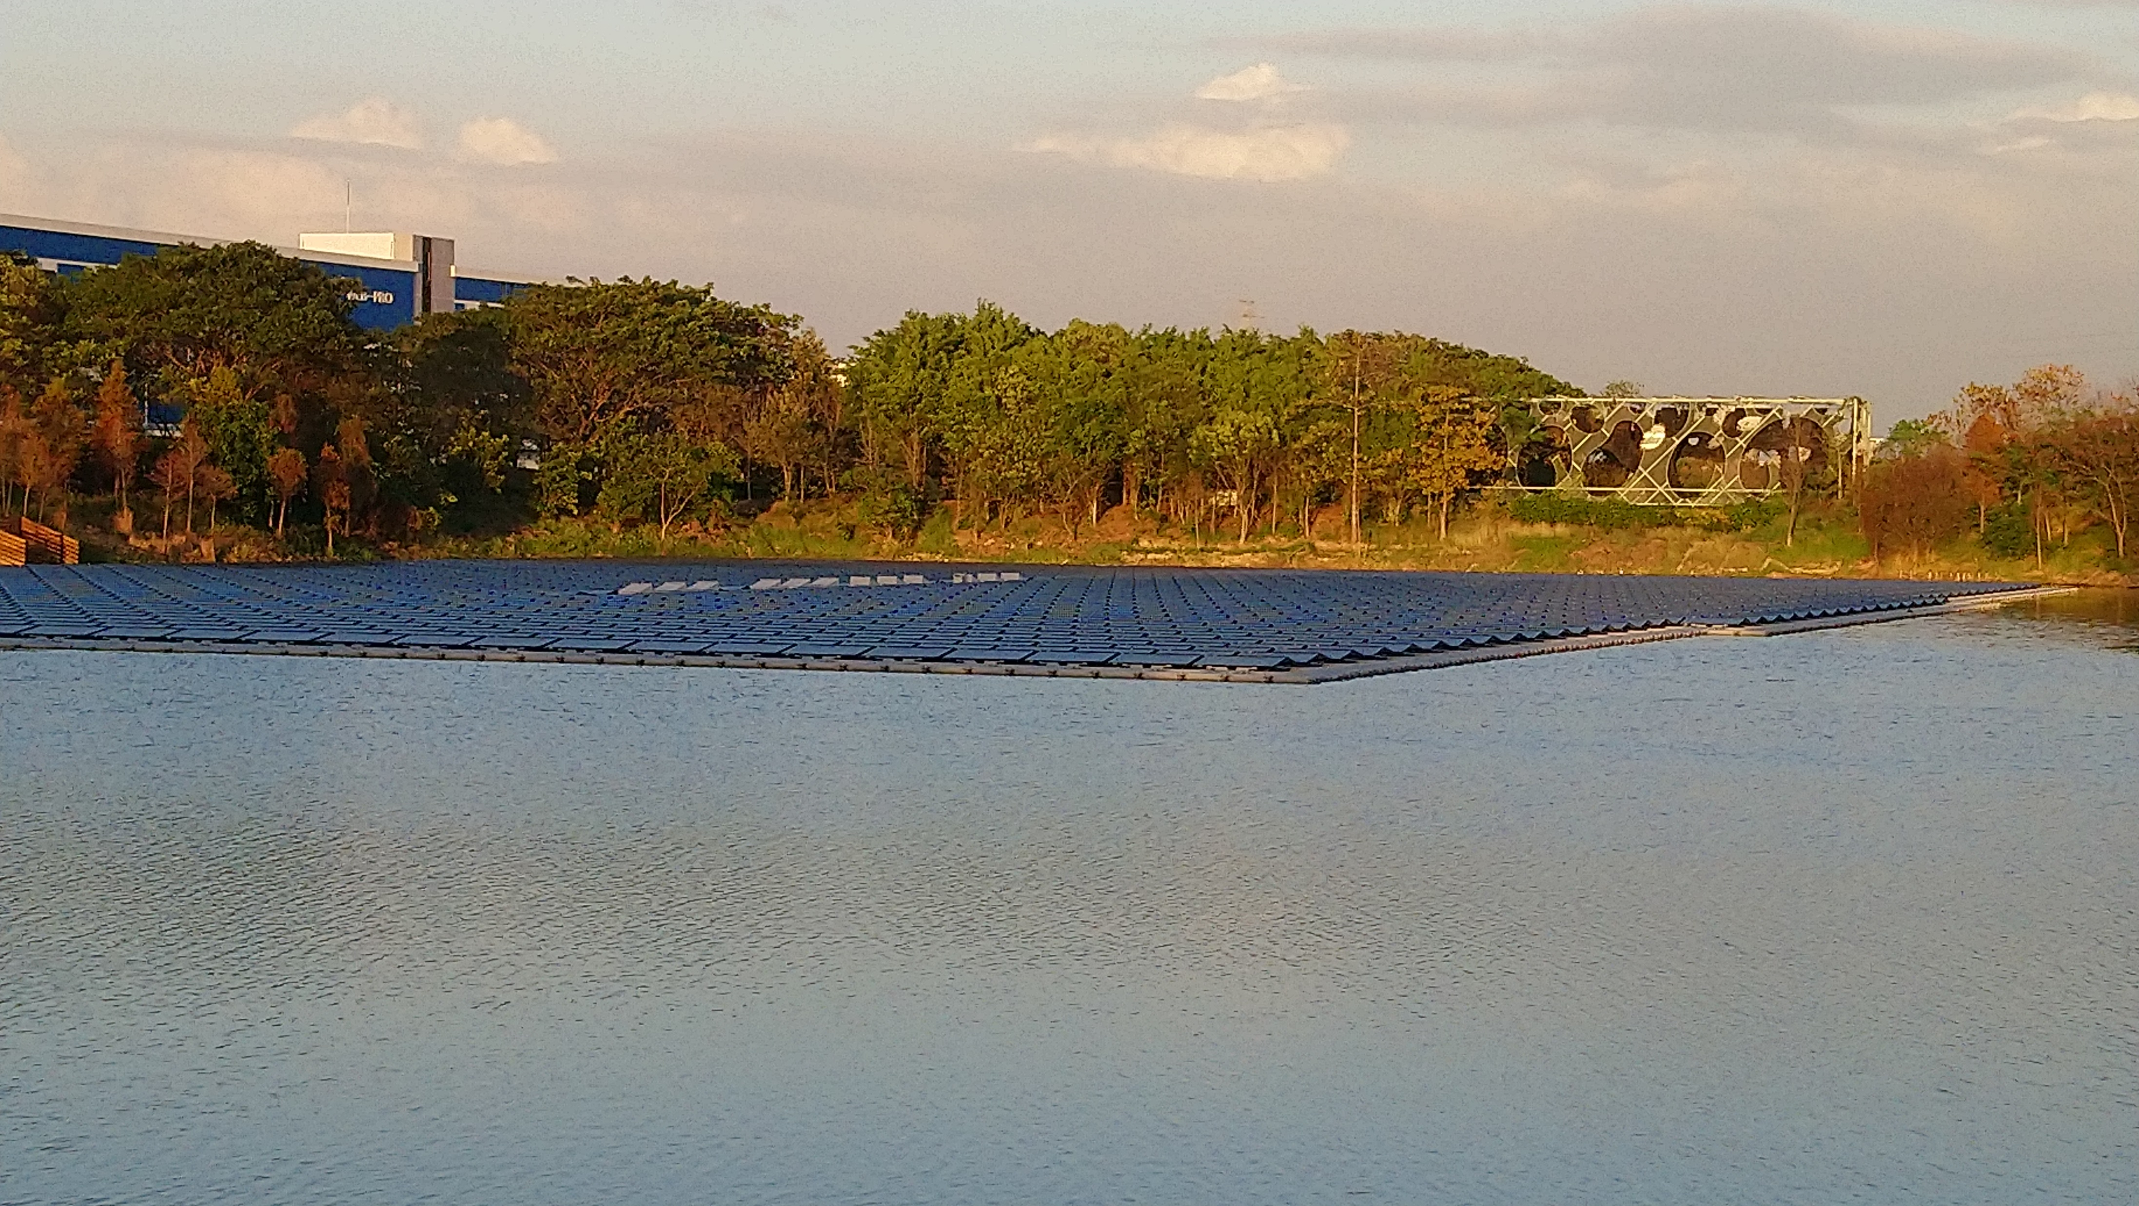
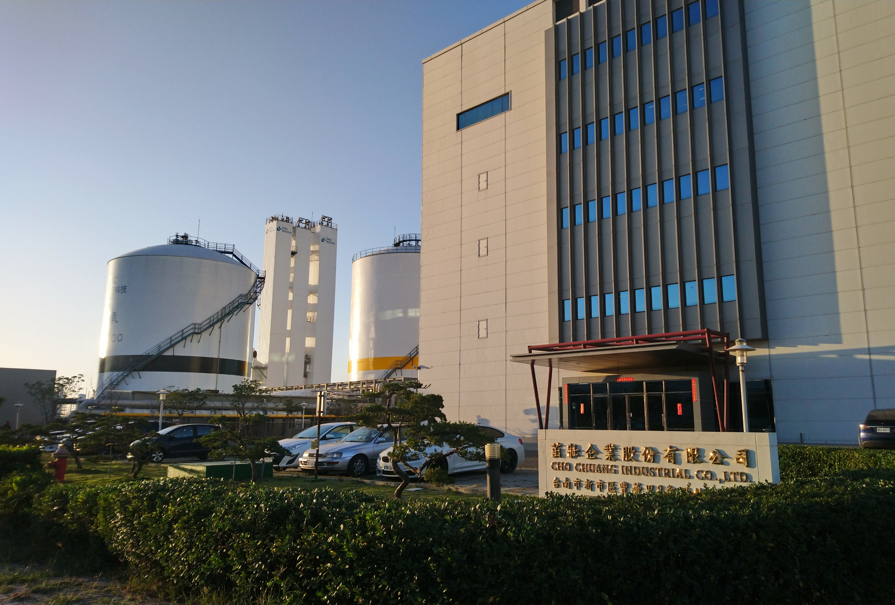
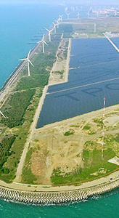
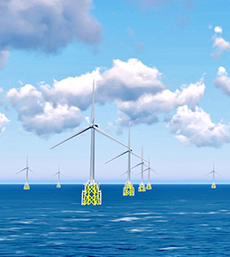
Green energy facility of Taiwan

