Slide 1

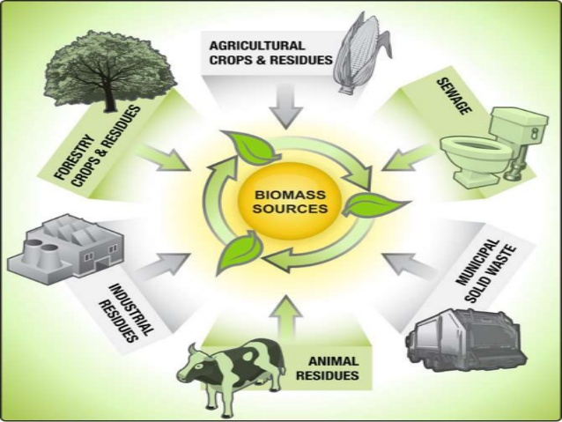

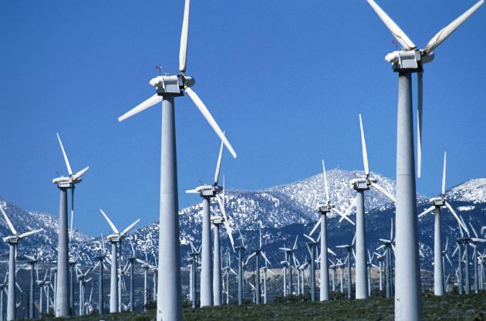
DEVELOP OF THE RENEWABLE AND SUSTAINABLE SOURCES OF ENERGY.

